Slide 1

Healing the Shame:
Male Sexual Assault &
Treatment Strategies
Lori Daniels, Ph.D., LCSW; Portland Vet Center, OR

Slide 2
All statements made are strictly the presenter’s and do not reflect the thoughts, opinions, or policies of the Dept. of Veterans Affairs nor the Dept of Defense.
Acknowledgements: numerous researchers whose work is cited in this presentation; MST resources provided by the DVA for use in community presentations/
  information. (esp V. Reynolds)

Slide 3
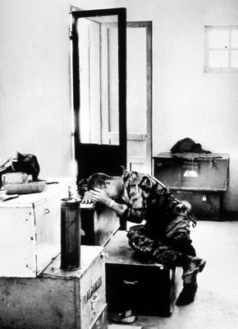
Talking about male sexual assault
A very uncomfortable topic for most people:
  Not discussed seriously
  Not discussed at all
  Gender specific topic if talked about at all
  Against societal norms, values, expectations

Slide 4
Acknowledgement of male sexual assault
The Uniform Military Code of Justice defined rape as something that only happens to females until 1992;
Laws begin to gender neutralize the definition of rape so men can seek justice (1994);
  States governments, not federal, govern legal statutes of rape: GA vs. CA laws.
Sexual Trauma Counselors hired by Vet Centers to assist military sexual assault survivors in counseling.

Slide 5
Lifetime prevalence rates of trauma and their association with PTSD (%)
Men Women
Event PTSD Event PTSD
Natural Disaster 18.9 3.7 15.2 5.4
Criminal Assault 11.1 1.8 6.9 21.3
Combat 6.4 38.8 0.0 -
Rape 0.7 65.0 9.2 49.5
Any trauma 60.7 8.1 51.2 20.4
Kessler et al (1995)

Slide 6
Gender Identity in Military Culture
A Good Soldier is…
  Physically strong
  Brave, courageous
  Heterosexual
  Suppresses:
    pain
    fear
    vulnerability
    weakness

Slide 7
Gender Identity in the Military Culture
A Real Man is…
  NOT feminine
  Heterosexual
  Physically strong
  Unemotional
  In control
Notes:
Now lets look at the Prototypical Male as its defined in our culture…

Slide 8
Male mst: Contributing issueS
Sexual Assault
Male Cultural
Military Culture
Existential problems

Slide 9
MST+ Masculinity
= HUGE Conflict
Sexual Trauma evokes everything that masculinity rejects:
  Fear
  Shame
  Vulnerability
  Helplessness/submission
  Intense, inescapable emotions
Notes:
These two aspects of a man’s identity go head to head….
The effects are Interactive, the trauma is compounded.

Slide 10
Male sexual assault & rape is PROTECTED INFORMATION by the survivor

Slide 11
Trauma healing can occur if survivor’s story is allowed to be revealed.

Slide 12
A few assumptions to make:
The assault, rape, or harassment was never reported OR attempts to report were not handled well;
The client has not told anyone about what happened to them in-depth;
They may prefer a female therapist
Past avoidance tactics have recently failed
They are very scared to do any therapy that may include disclosure & feelings

Slide 13
Before the work begins:
Move s l o w l y
  Assess counseling history
  Assess current living situation
  Assess current motivation to work on trauma history now
Educate
  About PTSD
  About your program, agency, or practice
  About other male survivors of ST/SH
    Normalize
  About your background
  (gives context for therapy work)

Slide 14
Intrusive Recollections: Memories, nightmares, flashes
Physiological Hyperarousal:
Vigilance, anxiety, diffic sleeping
Avoidance, Numbing:
Isolate, alcohol/drugs, withdrawal
TRIGGERS: subtle/ obvious
PTSD

Slide 15
Intrusive Recollections: Memories, nightmares, flashes
Physiological Hyperarousal:
Vigilance, anxiety, diffic sleeping
Avoidance, Numbing:
Isolate, alcohol/drugs, withdrawal
TRIGGERS: subtle/ obvious
Cognitive
Processing
GRIEF
GUILT
SHAME
HELPLESS
Prolonged
Exposure

Slide 16
Eventual Goal:
Trauma Processing
Safe Place
Strong Rapport
Cognitions
(distorted)
Allow for emotional expression
Provide feedback re: reality
INTEGRATIVE METHODS

Slide 17
If you have context, you can intervene more effectively.

Slide 18
Eventual Goal:
Trauma Processing
Safe Place
Strong Rapport
Cognitions
(distorted)
Allow for emotional expression
Provide feedback re: reality
Strong Rapport
INTEGRATIVE METHODS

Slide 19
How can a therapist “soften” the tension?
  Know that clients are watching closely (for reasons to discontinue; “Is this provider wanting to help me? Able to help me?”)
  Informal vs. formal approach: first name vs. Mr., Mrs., Dr., etc.
    Depends on program, care provider context
  Standardized assessments vs. open interview (first impressions)
  Flexibility with first few appointments: interaction

Slide 20

SURVIVOR’S CONTEXT
  Gender, Age, Race
  Previous experiences of loss, grief, tragedy
  Interpersonal characteristics (loner vs. social; supportive vs. acrimonious)
TRAUMATIC EVENT CONTEXT
  Includes type of trauma
  Frequency of events
  Societal context when (month/years) trauma occurred
  Cultural context surrounding traumatic event

Slide 21
DETERMINING TREATMENT INTERVENTION – Based on Traumatic Event Context
Societal Context
Beliefs/ values
Culture
Gender Context
Male
Female
Traumatic Event-specifics
1x event/ multiple
Military role
Year of assault
Sexual Orientation
Specific situation

Slide 22
Stats from my Caseload of male MST clients

Slide 23
Victims are left feeling confused
  “Was it rape?”
  “Was it my fault?”
  “Will anyone believe me?”
  “Will I be blamed, labeled, ostracized?”
  “If I report it, will it ruin my career?”
  “Everyone else likes (the perpetrator), so what will they think of me?”
  “I’m not sleeping at night, am constantly scared, can’t trust others, and wanting everyone to leave me alone.” (Katz, 2009)

Slide 24
QUESTIONS TO ASK THE CLIENT (assessing for current response pattern):
“What do you usually do when ___(memory) arises?”
“Does ___ (behavior) work?” What effect does that have for you? What function?”
“What emotions are you trying to change?”
“Have you ever allowed yourself to feel the emotions connected to your trauma?” (If so, what was that like?)
Notes:
But also change the world. (Well, at least your part of the world.)

Slide 25
Treatment Strategies to break old pattern, self-blame, and express emotions.

Slide 26
Trigger
Intrusive memory
Trauma-based thought
Physiological Hyperarousal
Avoidance/Detachment
PTSD Cycle

Slide 27
Trigger: walking in shopping mall; sees large man
Intrusive memory: Assault/rape
Trauma-based thought: that man looks like the guy who attacked me and I am in danger
Physiological Hyperarousal: hyper alert, watchful
Avoidance/Detachment: need to leave the mall
PTSD Cycle:
  Example of
  Male MST

Slide 28
Sights, sounds, scents, physical sensations, pain, emotions, anniversary time
Nightmares &/or memories about assault
Why can’t I get over it?
Anger at self for assault & not “getting over it”
Don’t think, don’t talk, don’t feel
Trigger: walking in shopping mall; sees large man
Intrusive memory: Assault/rape
Trauma-based thought: that man looks like the guy who attacked me and I am in danger
Physiological Hyperarousal: hyper alert, watchful
Avoidance/Detachment: need to leave the mall
PTSD Cycle:
  Example of
  Male MST

Slide 29
Sights, sounds, scents, physical sensations, pain, emotions, anniversary time
Nightmares &/or memories about assault
Why can’t I get over it?
Anger at self for assault & not “getting over it”
Don’t think, don’t talk, don’t feel
Allow for emotions/feelings related to incident(s)
Healing the Shame
Integrative Therapy

Slide 30
Eventual Goal:
Trauma Processing
Safe Place
Strong Rapport
Cognitions
(distorted)
Allow for emotional expression
Provide feedback re: reality
Trauma Processing
INTEGRATIVE METHODS

Slide 31
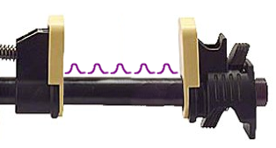
Despondent
Despair
Helpless
Grief
Satisfied Confident
Optimistic Excited Thrilled Enthusiastic Ecstatic Joyful
Sadness Depressed Low Disappointed
Numb "Okay" "Fine" No Feeling
Anger Irritated Agitated Frustrated
Fear Loneliness Hurt, Solemn
Acceptable range
VICE GRIP ON EMOTIONS
AFTER TRAUMATIC EVENTS
© Daniels, 2012

Slide 32
QUESTIONS/STATEMENTS TO THE CLIENT:
“What emotions are you aware of right now? Where in your body are your feeling them?”
“I notice that you are hunched over and looking down... What’s going on?” (wait wait wait for the answer)
Combining assessment and observing: more information.
Notes:
But also change the world. (Well, at least your part of the world.)

Slide 33
SIMULTANEOUSLY, QUESTIONS TO ASK YOURSELF: (gathering data via “watching” and “listening”)
“What is their affect/body-posture/gaze?”
“Do I hear statements suggesting loss, guilt, unresolved grief?”
“What statements of ‘I am’ can I infer from what I’m hearing?”
“How old would I guess the client is as they are talking with me now? (how they present themselves)?”
Notes:
But also change the world. (Well, at least your part of the world.)

Slide 34
So many options: clinical intuition
Watch/Listen:
Body posture, eyes
Statement about self
Specifics about traumatic incident
  Decisions made
  Full context of situation
  Use of outcome to flavor decisions made during crisis
Therapist options:
(just like they taught us in school – just mix it up)
Summary
Reflection
Deeper level questions
Extra information/educ
Focus on emotions
Listen... listen, watch, wait, listen more.
  The whole time thinking
    “What didn’t happen that needs to in order to get unstuck?”
Notes:
But also change the world. (Well, at least your part of the world.)

Slide 35
Now, we can intervene:
Don’t think, don’t talk, don’t feel
Sights, sounds, scents, physical sensations, pain, emotions, anniversary time
Educate about specific triggers, unique to the client’s trauma story; dynamic
Allow all emotions: sad, guilt, grief, anger, challenge distorted recall (excessive responsibility/ control); focus on what to do next . What can help move this energy.
Anger at self for assault & not “getting over it”
Nightmares &/or memories about assault
Listen for anger: self-blame? Guilt? Self-denigration? Loss? Betrayal?
Educate about specific triggers; what contributes to certain nightmares?
Educate about Male MST; normalize reaction, educate about PTSD and stuck emotions
Why can’t I get over it?

Slide 36
For specific emotional stuck points:
Guilt:
Guilt:
Degrees of responsibility (Scurfield, 2013)
  Assess full context of traumatic incident, all people making decisions
  Assign responsibility % to each decision-maker, including client and perpetrator (who gets majority %)
  Challenge distorted level of responsibility by client
  Negotiate reasonable level of % for client; account for # of years of self-punishment
Hind-sight Bias (Kubany, 1990?)
  Assess full context of traumatic incident, including information known by client at the time (age, experience)
  Ask: Given what you knew… vs. what you know now…, possible to make the same decision?

Slide 37
For specific emotional stuck points:
Grief:
Anger:
Mailing a message
  Client writes out a letter to perpetrator(s) and shares feelings
  Facilitate “mailing” of the letter
  Debrief the process each step of the way
Gardening, exercise, Wii
  Listen for statements or behaviors suggesting pent-up energy that never was expressed (action)
  Fit the behavior with options for the client
    If not possible, can use a Wii to box or swordfight avatar figure representing perpetrator(s)

Slide 38
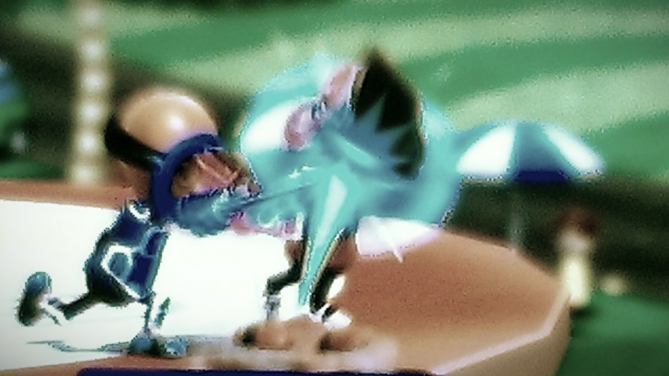
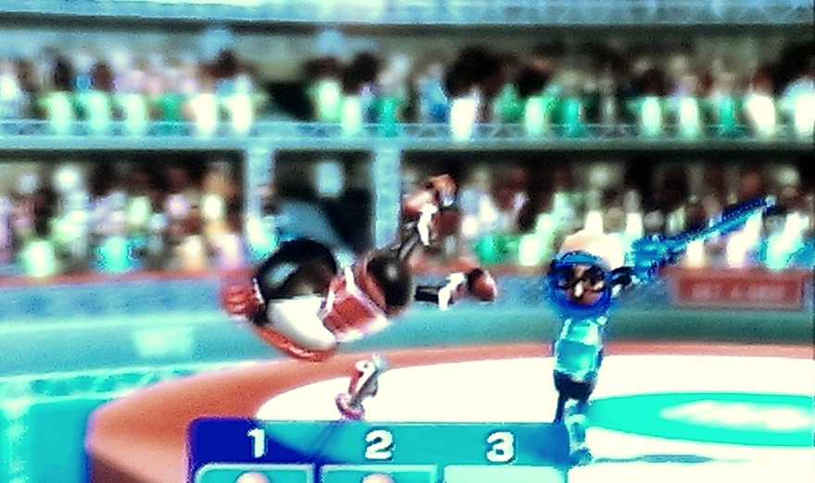
1st time: the vet boxed the figure and afterwards stated he felt pleasure, satisfaction, and "a release" of pressure. Smiled as he said that he’d be willing to do this again. Vet discussing his continued PTSD symptoms. He appeared to benefit from using a virtual simulation of him fighting back his perp. Was pleasantly surprised at how positive he was feeling afterwards.
2nd time: He went 6 times, knocking the image of his perpetrator off a platform and into the water; and we discussed afterwards. He said that the boxing and sword fighting (with a virtual light saber looking weapon, blue) were similar in terms of him feeling as if he expended energy. Smiled as he admitted that he once again was enjoying the cathartic aspect of the sword fighting and getting a chance to finally "fight back". …. Initially, the vet felt guilty about using the Wii system, in spite of his admission that he felt some long-term benefits ("I don't want to waste your time... I noticed that hours later, I actually found myself feeling even more glad I was able to fight back than even during the first few minutes when I did the boxing last time...").
3rd time: The veteran stated that the night after our last session, he had his usual nightmare, but that there was more emphasis on his saber - and he described it as more bright and a focal point of his attention (which resulted in the dream stopping at that point). The dream ended as he was noting that the saber was brighter. He felt a little panicked upon awakening, but also relieved because it wasn’t as bad as other occurrences of the nightmare has been. "It was like the saber stopped it... I wish that it could have continued a little longer..." The vet played the Wii “Sword play” game about 10-12 times. “It really does have therapeutic value to me… I can’t describe it… but if really feels like it’s helping me…”

Slide 39
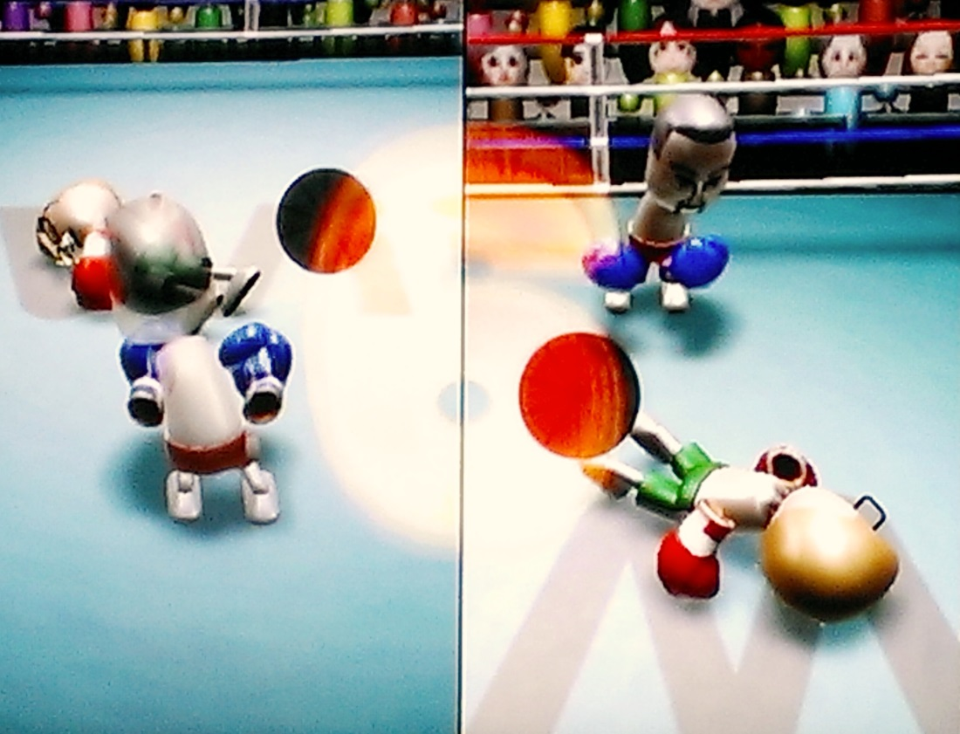
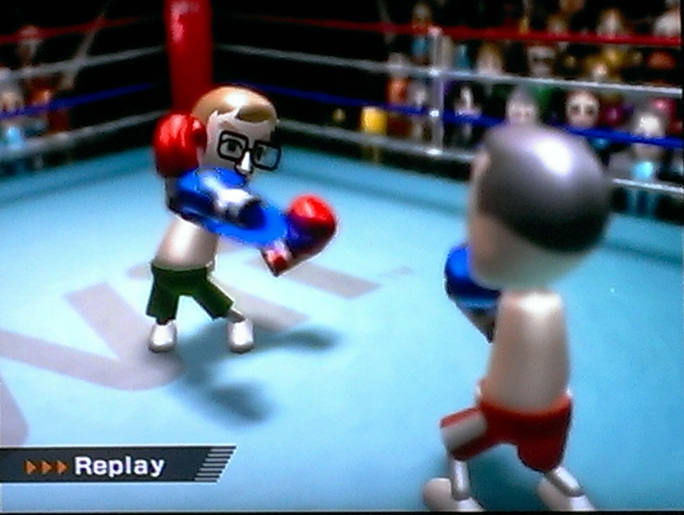
1st time: Opted to use boxing, and the vet requested that I "fight back" with the other wand representing the perp. Instead, this writer opted to dodge the vet's punches, which appeared to keep the vet occupied w/ trying to knock-out the Mii representing his perpetrator. “I’m pretty exhausted now… “ He admits that the boxing seems to fit better with the level of energy that he has against his perpetrator from the Army. We also took digital photos of the vet’s victorious moments (K.O.’d the perp) which was emailed to him to print.

Slide 40
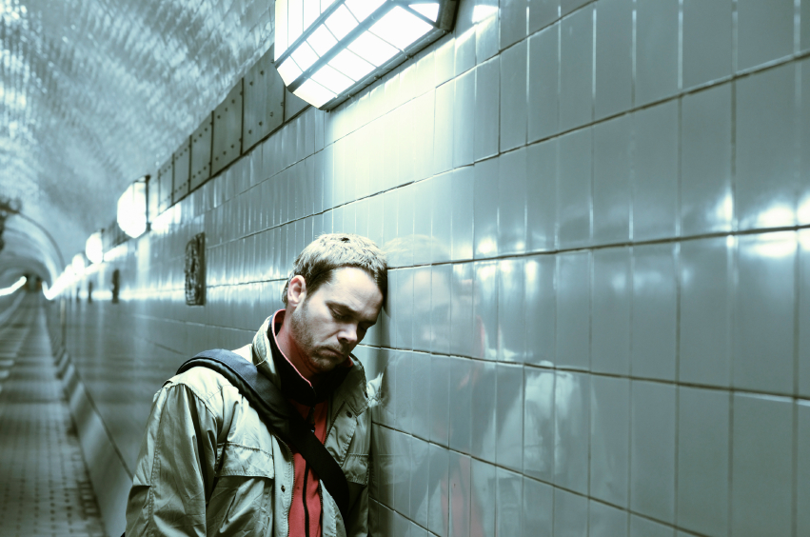
Education: PTSD sx; triggers
Nightmare Therapy: gestalt
Trauma disclosure: client-centered
Statement: “I can’t move, there’s nothing I can do.”
Letter written, burned
Emotions: embarrassed, helpless

Slide 41
Emotionally processing traumatic events: Goals
Increased understanding of one’s own unique PTSD symptoms & triggers
Reduction of hyperarousal & reexperiencing symptoms
Reduction of distorted beliefs
Gain insight
Reduction of dysfunctional coping
Permission to have all emotions
Increased self-worth

Slide 42
myduty.mil (for current or recently deployed)
www.jimhopper.com
www.malesurvivor.org
Boys and Men Healing (documentary)
The Invisible War (documentary)
Playing With Fire by Theo Fleury
Honor Betrayed: Sexual Abuse in America’s Military Mic Hunter, 2004
The Sexually Abused Male: Application of Treatment Strategies Mic Hunter, 1990
Lori.daniels@va.gov

