Slide 1
From Bars to Grindr to Fatherhood: Clinical Work With Gay Men
Jay Robertson-Howell, Psy.D., MSSW
California State University San Marcos
The 4th National Psychotherapy with Men Conference

Slide 2
Participants will be able to:
Identify three reasons that gay men might seek mental health services
Identify three societal issues that impact the psychological well-being of gay men
Identify the underlying emotion impacting the gay male’s psychological functioning
Identify three strategies in developing an affirmative therapeutic approach in our work with gay men

Slide 3
Mental Health Disparities
Health Disparities
Clinical Issues
Coming Out
Substance Abuse
HIV/AIDS
Relationship Issues

Slide 4
Mental Health Disparities
Gay and bisexual men showed higher prevalence of depression, panic attacks and psychological distress than heterosexual men (Cochran et al., 2003).
According to Remafedi et al. (1998), young gay and bisexual men may be 7x more likely to attempt suicide than young heterosexual men.
Although gay men are more likely than their heterosexual counterparts to seek help for emotional distress, approximately 1/3 of gay men reported negative or mixed reactions from mental health professionals (King et al., 2003).

Slide 5
Mental Health Disparities
Gay men exhibited lower self-esteem if they believed that appearance, weight, and muscularity were important to others (Fish, 2006).
Kaminski et al. found that gay men also believed that increased muscularity would offer protection from physical attack (2005).
Disclosure of one’s identity to others is usually associated with better mental health (Morris et al., 2001), but other factors need to be considered during the coming out process.

Slide 6
Health Disparities
Gay men, as well as anyone who has receptive anal sex, are at higher risk for anal cancer due to an increased risk of becoming infected with human papillomavirus (HPV) with gay and bisexual men estimated to have 1 17x more likely chance to develop anal cancer than heterosexual men(McRee, et al., 2010, Tider et al., 2005).
“Some disparities, such as HIV and other sexually transmitted infections, are associated with the sexual practices of men who have sex with men (MSM)” (Wolitski, et al., 2008, p. 23).
Gay men may experience violence based on their sexual minority status and/or within an intimate relationship (Herek, 2009 and Houston, et. al., 2007).

Slide 7
Substance Abuse
Controversy related to the rate of alcohol use historically reported to be 3x the general population
  Bars as social gathering places, accessibility of alcohol, and cultural norms of alcohol use
  Alcohol use as a coping strategy for discrimination
Recent studies show that gay men use substances, including alcohol and illicit drugs at a higher rate than the general population – not just in large communities like NY, San Francisco or Los Angeles (Ostrow and Stall, 2008)
Gay men and lesbians were more likely than heterosexuals to have used recreational drugs (King, et al., 2003).
“Use of poppers appears to be a gay male phenomenon (Fish, 2006).

Slide 8
So health disparities appear to be the result of:
DISCRIMINATION
HOMOPHOBIA
HETEROSEXISM
STIGMA
and a culture that idolizes MASCULINITY
Not to dismiss biological and genetic factors

Slide 9
Historical Persecution
The Holocaust and the
The Stonewall Riots
Mental Health Disorder until 1974
  Reparative Therapy still promoted as a cure
Same-sex sexual activity criminalized in 14 states until 2003 – Lawrence v. Texas
Same-sex marriage and adoption by same-sex couples still illegal in many jurisdictions

Slide 11
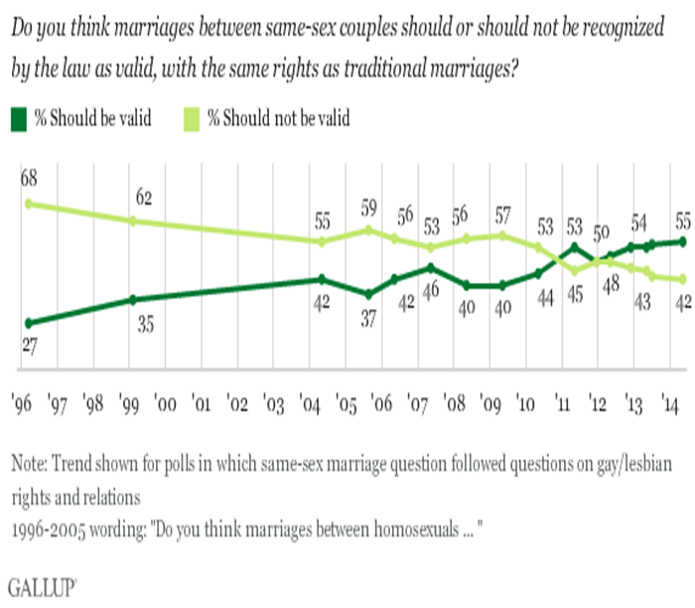

Slide 14
Examples of Privilege
Being able to marry the person you love in all 50 states and having that marriage recognized federally
Not having the need to “come out”
Knowing that I won’t be fired from my job based on my sexuality
Having the security that my children will not be taking away from me based on my sexuality
Having the freedom to talk about LGBT issues without being accused of “forcing a homosexual agenda” on others
Not having economic, emotional, physical, or psychological consequences if family and friends find out about my sexuality

Slide 15
Minority Stress
Premise that gay people in a heterosexist society are subjected to chronic stress related to their stigmatization (Meyer, 1995)
Minority stress can be experienced in the form of ongoing hassles (such as hearing anti-gay jokes) and more serious negative events (such as loss of employment, housing, custody or children, and physical and sexual assault) (DiPlacido, 1998)

Slide 16
Microaggressions
“The everyday encounters of discrimination that people of various marginalized groups experience throughout their lives” (Sue et al. 2007)
“Brief and commonplace daily verbal, behavioral, or environmental indignities, whether intentional or unintentional, that communicate hostile, derogatory, or negative slights and insults toward members of oppressed groups” (Nadal, 2008, p. 23)

Slide 17
The Intersection between sexuality and masculinity
Living in a culture that worships masculine power
Being a gay man in a hyper masculine world
Being a gay man in a heterosexual society
Results in:
  Living outside the BOX
  SHAME

Slide 18


Slide 19
“To be gay in an uncompromisingly straight world is to struggle to find love and, once found, to hold on to it. We are men in a world where men are emotionally disabled by our masculine cultural ideals (Downs, 2012, p. 62)

Slide 20
Down’s 3-Stages
Overwhelmed by shame
Compensating for shame
Cultivating authenticity

Slide 21
Stage 1: Overwhelmed by shame
Overwhelmed with being gay in a society that promotes masculine power
Coping equals avoidance
Engaging in any behavior that works to lessen the feeling of shame

Slide 22
Avoidance Strategies
Suicide
  LGBT youth are 2-3 times more likely to attempt suicide (Garofalo, et al., 1999)
Substance Abuse
Anonymous Sex
  Grindr and other sites
Denying sexuality
  Hyper sexuality with women
  Getting married and starting families
  Bisexuality
  Anti-gay activities

Slide 23
Stage 2: Compensating for Shame or the “Best Little Boy in the World” syndrome
“Best Little Boy in the World”
Ongoing search for validation
  Stage 1 validation equals hiding sexuality
  Stage 2 validation equals proving worth and deserving of love
Hunger for validation and hypersensitivity to invalidation
Inauthentic validation satiates briefly
  Anonymous sex, promotions at work, body image and muscularity

Slide 24
Stage 3: Cultivating Authenticity
Rediscovering the essence of self and the deconstruction of life built on shame
Decreased visibility in gay community
Movement towards distress in an effort to overcome avoidant behavior
Reclaiming life that might be marked by ambiguity
Aligns with Cass’s synthesis stage

Slide 25
http://www.youtube.com/watch?v=R4PV4Vyluc8#t=10

Slide 26
Identity Development
Foreclosure v. acceptance
  An unfulfilled life v. a fulfilled life
  A conflict in values
Intersection between multiple identities
  Sexuality
  Masculinity
  Race, ethnicity and national origin
  Age
  Ability
  Socioeconomic status

Slide 27
Affirmative Therapy
Clark (2009) suggested that therapists help LGBT clients establish a support system of other LGBT individuals, help LGBT clients understand how oppression has affected them, help desensitize the shame and guilt associated with homosexual thoughts, behaviors, and feelings, and allow for client’s expression of anger at being oppressed.
Davies (1996 ) suggested that therapists amplify Roger’s core provision of unconditional positive regard in working with LGBT clients.

Slide 28
Affirmative Therapy
Internalized homophobia a target for therapeutic intervention
Explores the effects of anti-homosexual prejudice on the presenting complaint and therapeutic process
Foster the development of all aspects of an LGB client’s identity and the enhancement of an LGB individual’s experiences.

Slide 29
Acceptance and Commitment Therapy
Work in assisting client to understand the different emotional experiences he might be having and ways in which he engages in avoidance strategies
Identify and work with values
Establish a plan of committed action that moves client forward in living an authentic and fulfilling life

Slide 31
Case Example
Older than average student presenting with depression seen for 10 sessions over the course of a semester
Existential outlook which led to a negative self-concept
  Inability to solve life’s problems
  Strong comparison to peers
  “should be in a different place”
Search for validation in an effort to minimize the effects of shame

Slide 32
What can we do as clinicians?
Ongoing education related to LGBT issues
  Developing competency
  Knowledge, skills, and attitudes
A therapeutic space that reflects inclusiveness
  Safe Zone
  Pamphlets reflecting same-sex couples
Develop a therapeutic alliance that values diversity
Be familiar with APA Guidelines for Psychological Practice with Lesbian, Gay & Bisexual Clients

Slide 33
Questions
Jay Robertson-Howell, Psy.D., MSSW
California State University San Marcos
Student Health and Counseling Services
jrobertson@csusm.edu
760-750-4974

Slide 34
References
Clark, D. (2009). Loving Someone Gay. Maple Shade, NJ: Lethe Press.
Cochran, S. D., Mays, V. M. and Sullivan, J. G. (2003). Prevalence of mental disorders, psychological distress, and mental health services use among lesbian, gay, and bisexual adults in the United States. Journal of Consulting and Clinical Psychology, 71, 1: 53-61.
Davies, D. (1996). Towards a model of gay affirmative therapy. In D. Davies & C. Neal (Eds.), Pink Therapy: A Guide for Counselors and Therapists Working with Lesbian, Gay, and Bisexual Clients. Buckingham, England: Open University Press.
Fish, J. ( 2006). Heterosexism in Health and Social Care. NY: Palgrave Macmillan.
Garofalo, R., Wolf, R.C., Wissow, L.S., et al. (1999). Sexual orientation and risk of suicide attempts among a representative sample of youth. Archives of Pediatric and Adolescent Medicine, (153(5), 487-493.
Herek, G.M. (2009). Hate crimes and stigma-related experiences among sexual minority adults in the United States: Prevalence estimates from a national probability sample. Journal of Interpersonal Violence, 24(1), 54–74.
Houston, E., & McKirman, D.J. (2007). Intimate partner abuse among gay and bisexual men: Risk correlates and health outcomes. Journal of Urban Health, 84(5), 681–690.
Kaminski, P. L., Chapman, B. J., Haynes, S. D. And Own, L. (2005) Body image, eating behaviors and attitudes toward exercise among gay and straight men. Eating Behaviors, 6, 3: 179-187.

Slide 35
References
King, M., McKeown, E., Warner, J., Ramsay, A., Johnson, K., Cort, C., Wright, L. et al. (2003). Mental health and quality of life of gay men and lesbians in England and Wales: Controlled, cross-sectional study. British Journal of Psychiatry, 183, 6: 552-558.
McRee, A. L., Reiter, P. L., Chantala, K., et al. (2010). Does framing human papillomavirus vaccine as preventing cancer in men increase vaccine acceptability? Cancer Epidemiology Biomarkers and Prevention, 19(9), 1937.
Morris, J., Waldo, C. R. and Rothblum, E. D. (2001). A model of predictors and outcomes of outness among lesbian and bisexual women. American Journal of Orthopsychiatry, 71, 1: 61-71.
Morrow, SL. (2000). First do no harm: therapist issues in psychotherapy wit lesbian, gay, and bisexual clients. In RM Perez, KA DeBord, & KJ Bieschke (Eds.), Handbook of Counseling and Psychotherapy with Lesbian, Gay, and Bisexual Clients (pp. 137-156). Washington, DC: American Psychological Association.
Ostrow, D.G., & Stall, R. (2008). Alcohol, tobacco, and drug use among gay and bisexual men. In Wolitski, R. J., Stall, R., & Valdiserri, R. O., (Ed.) Unequal opportunity: Health disparities affecting gay and bisexual men in the United States. New York: Oxford University Press
Remafedi, G., French, S., Story, M., Resnick, M. D. and Blum, R. (1998). The relationship between suicide risk and sexual orientation: Results of a population-based study. American Journal of Public Health, 88, 1: 57-60.
Tider, D.S., Parsons, J.T., & Bimbi, D.S. (2005). Knowledge of human papillomavirus and effects on sexual behavior of gay/bisexual men: A brief report. International Journal of STD & AIDS, 16, 707–708.

